Slide 1
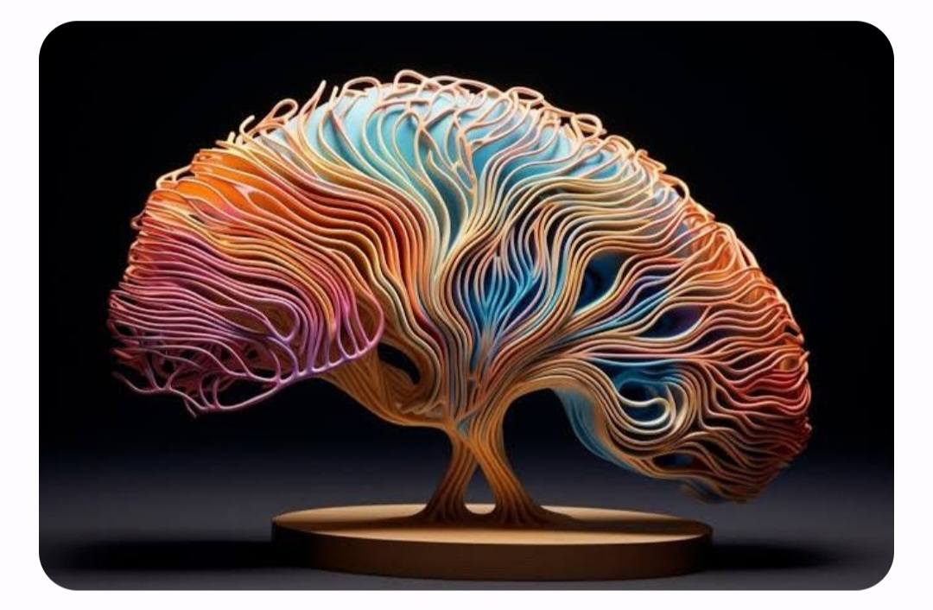
Brain Tumor Classification
Alin Finkelshtein and Felix Doctorman

Slide 2
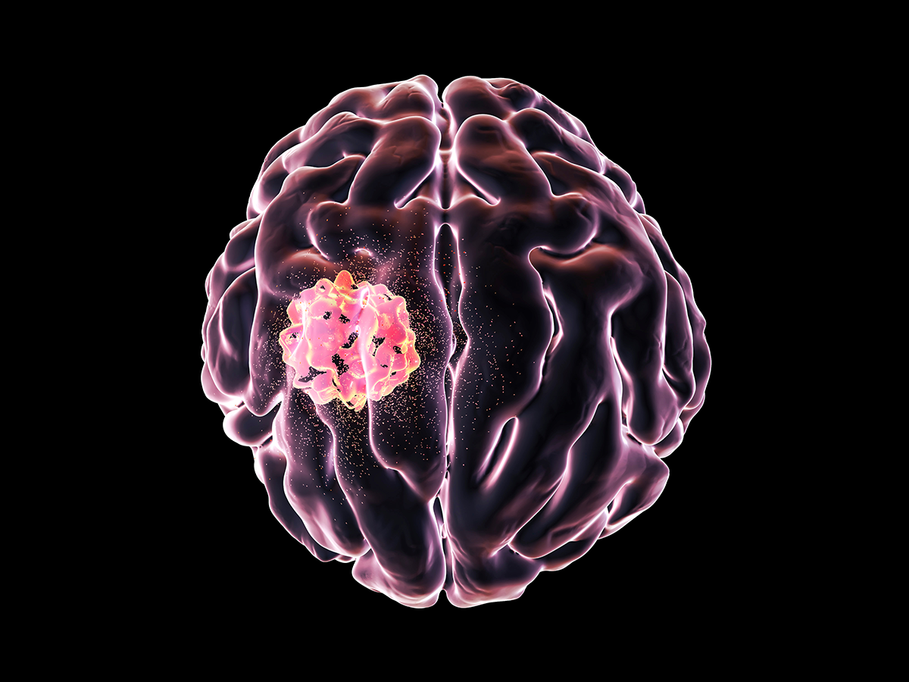
Brain tumors
Optic nerve glioma
Medulloblastoma
Neurofibroma
Mixed glioma
Hemangioblastoma
Ependymoma
Oligodendroglioma
Glioblastoma multiforme
Craniopharyngioma
Gliomas
Pituitary adenoma
Astrocytoma
Choroid Plexus Tumors
Brainstem glioma
Schwannoma
Benign (noncancerous)
72%
Malignant (cancerous)
28%
Meningioma
50/50 chance of being cancerous
Chordoma
Primary central nervous system lymphoma
Vestibular schwannoma
Pilocytic astrocytoma
Germ cell tumor
Primitive neuroectodermal tumor
diffuse Astrocytomas
Anaplastic astrocytoma
Notes:
Less than 1 percent of the population is diagnosed with a malignant (cancerous) brain tumor during their lifetime.
There are more than 120 brain tumors. Classified by their location and type of cells they are made of.
Certain types of tumors are typically benign (noncancerous), while others are typically malignant (cancerous). Others may have a 50/50 chance of being cancerous.

Slide 3
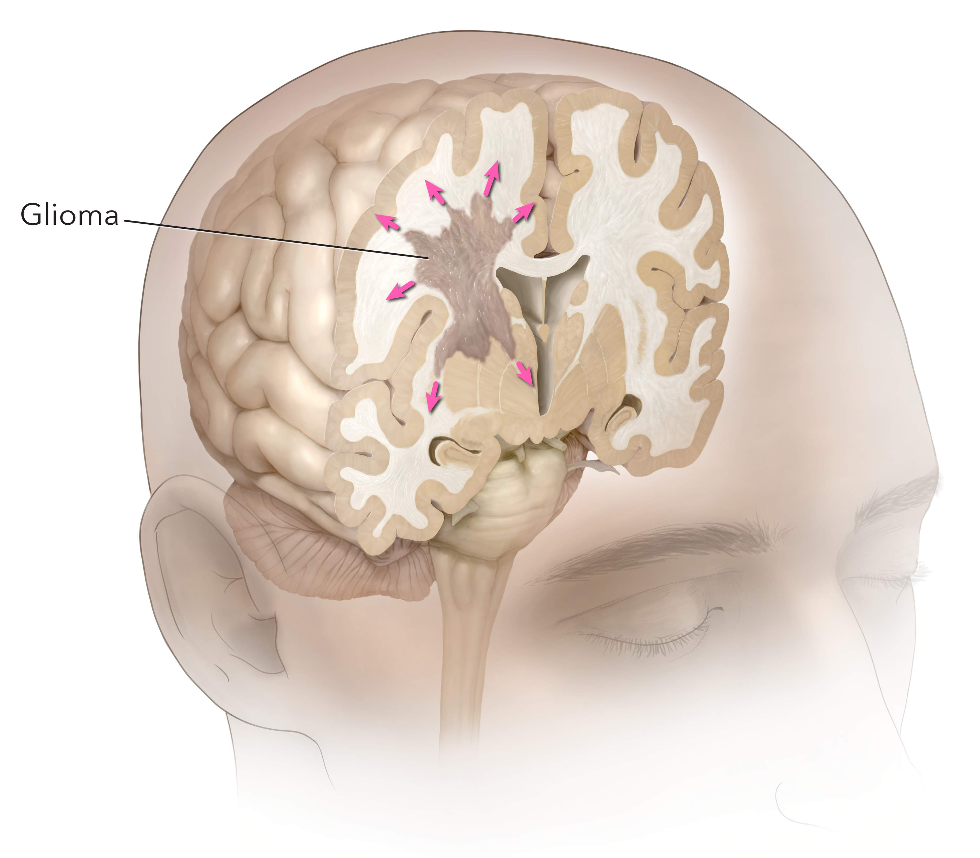
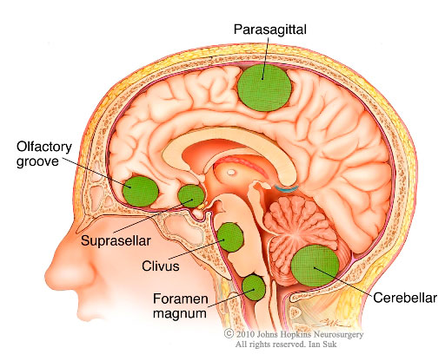
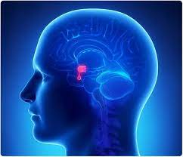
Glioma
Meningioma
Pituitary adenoma
Glioma starts in the glial cells
About 33% of all brain tumors
Gliomas can affect all ages, but they are most often seen in adults.
There are different gliomas, with different growth potential and aggressiveness
Variable Grades of aggressiveness (From Benign to Malignant)
Symptoms of glioma appear slowly and may be subtle at first. Some gliomas do not cause any symptoms .
Meningioma starts in the meninges, which are membranes surrounding and protecting the brain.
30% percent of all brain tumors.
They grow slowly and may exist for years before being detected.
Most meningioma tumors are benign.
Pituitary tumor starts in the pituitary gland.
About 25% of people may have small pituitary tumors
It is located behind the back of the nose.
It makes hormones that affect many functions in your body.
Most pituitary tumors are benign.
They don’t spread to other parts of your body
They can cause vision and endocrinological problems
Most pituitary tumors don’t cause symptoms. As a result, they are not diagnosed.
Notes:
Glioma is the most common cancerous tumor
Meningioma is the most common benign tumor
הִיפּוֹפִיזָה

Slide 4
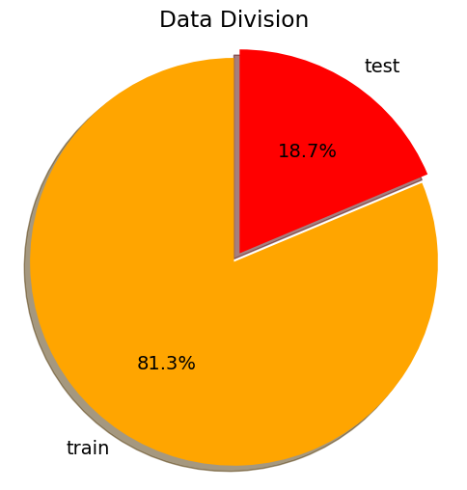
The data
Train
Test
Glioma
Meningioma
Notumor
Pituitary
Glioma
Meningioma
Notumor
Pituitary

Slide 5
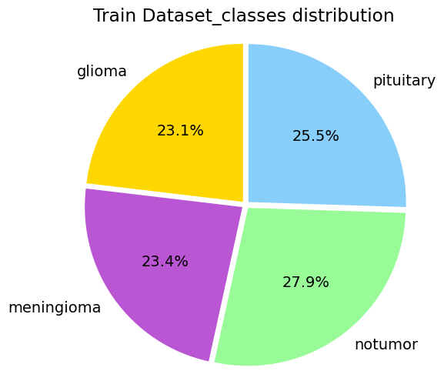
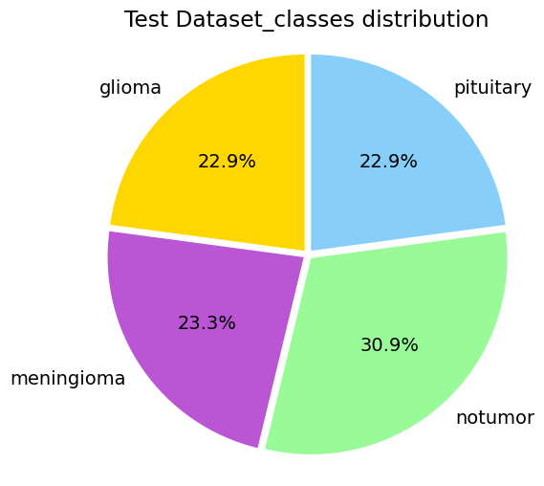
The classes are balanced

Slide 6
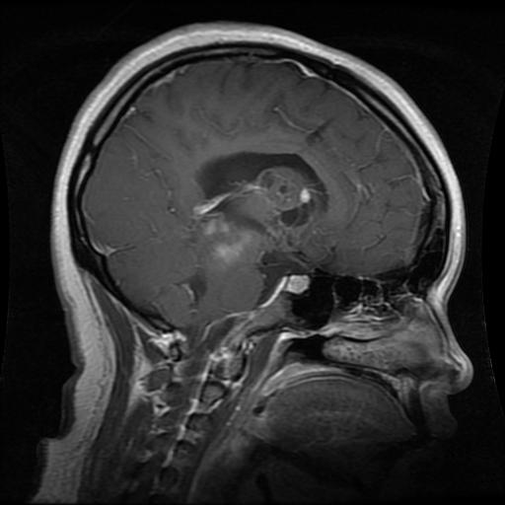
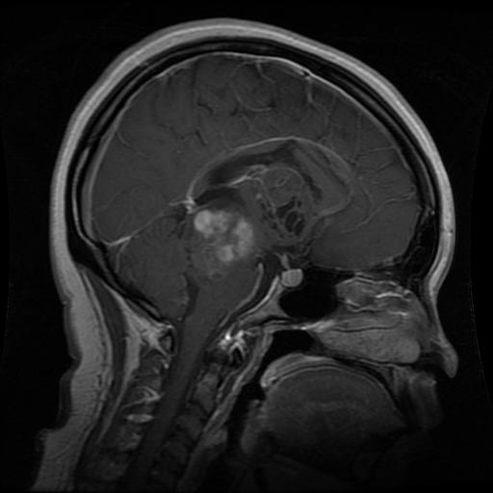
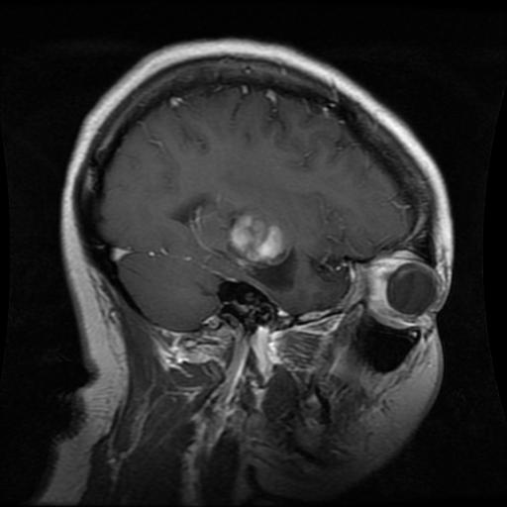
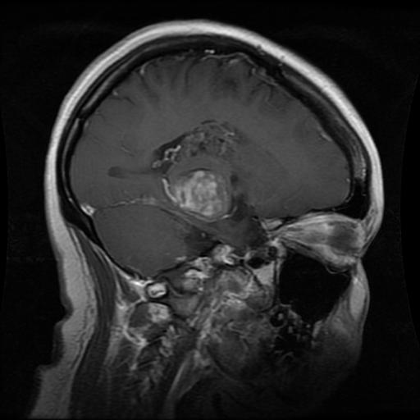
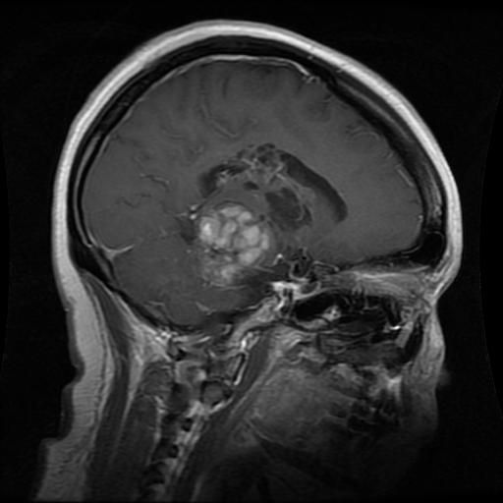
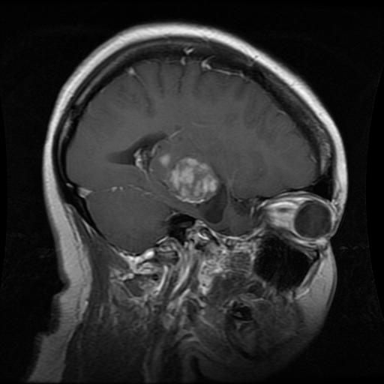
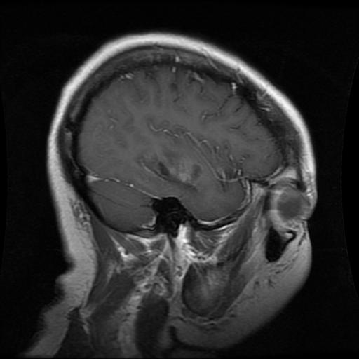
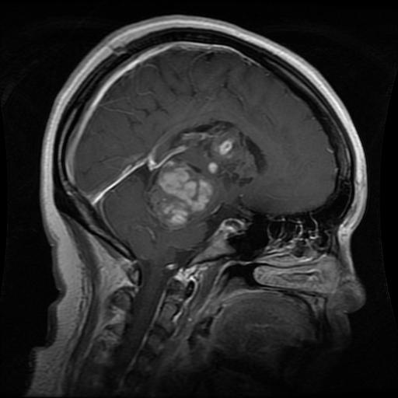
MRI Slicing

Slide 7
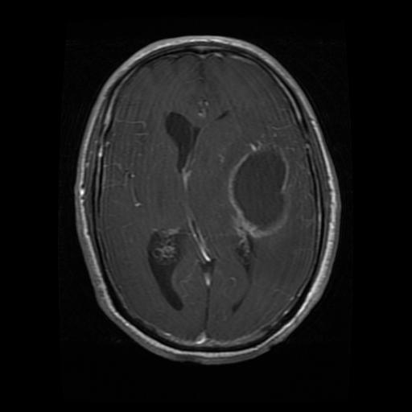
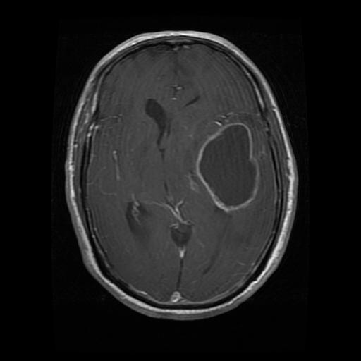
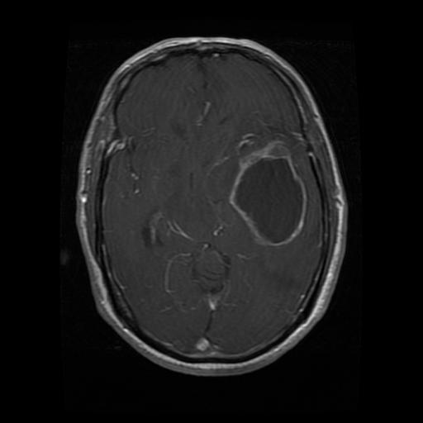
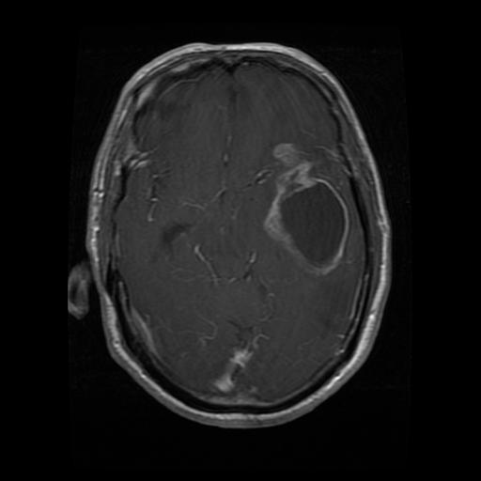
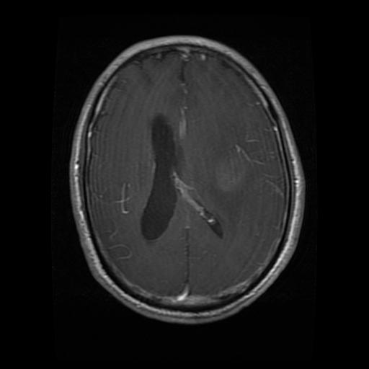
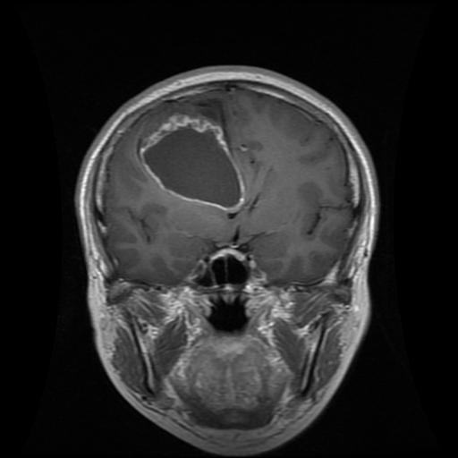
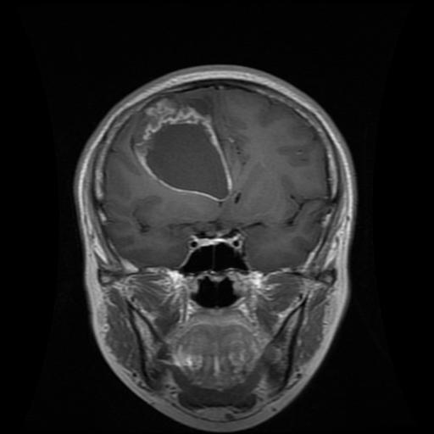
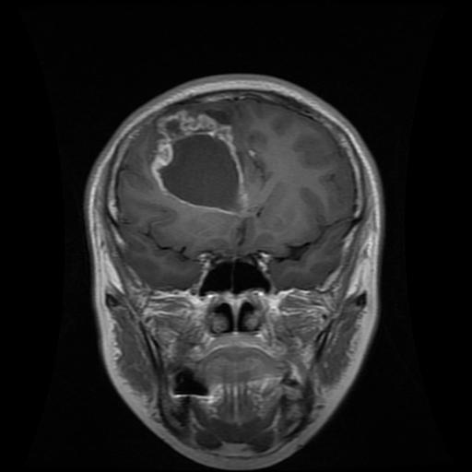
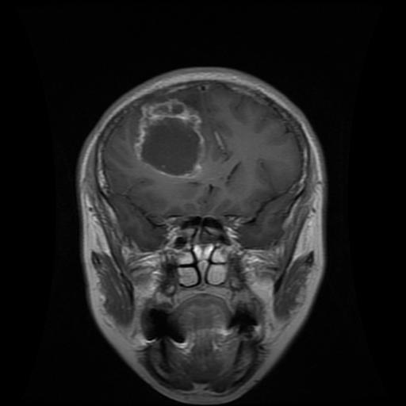
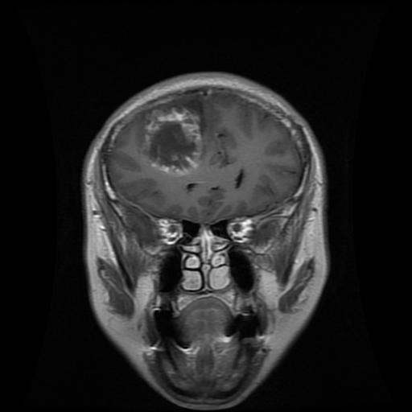
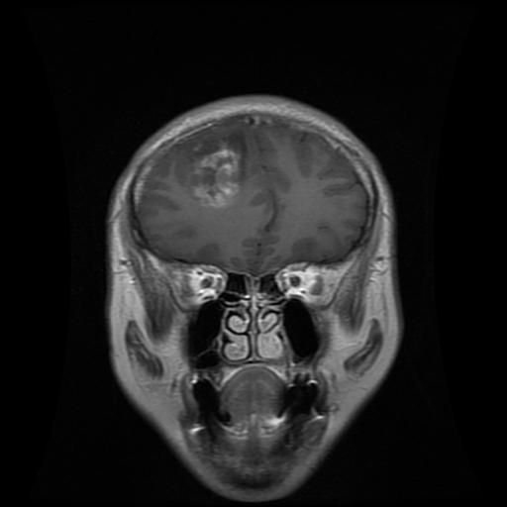

Slide 8
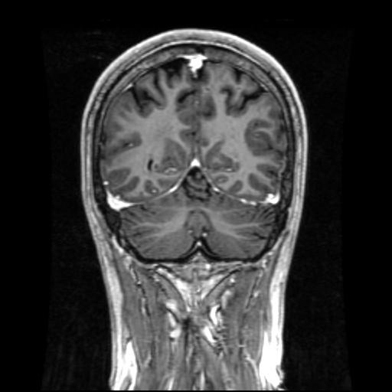
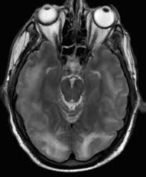
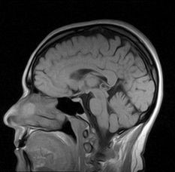
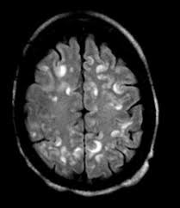
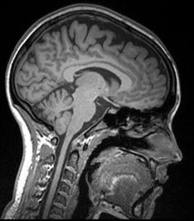
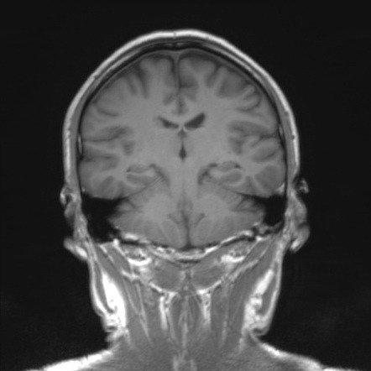
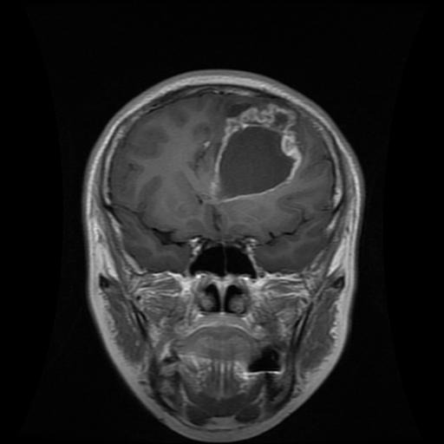
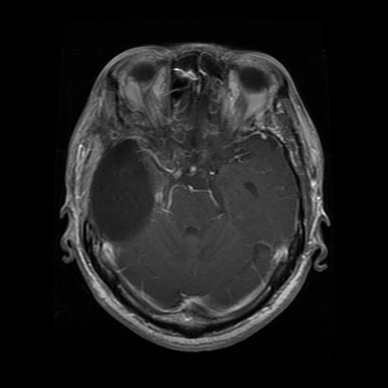
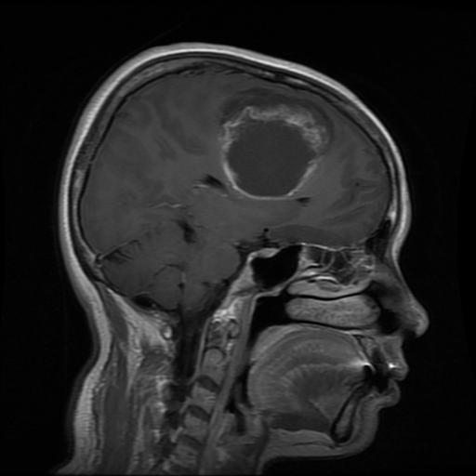
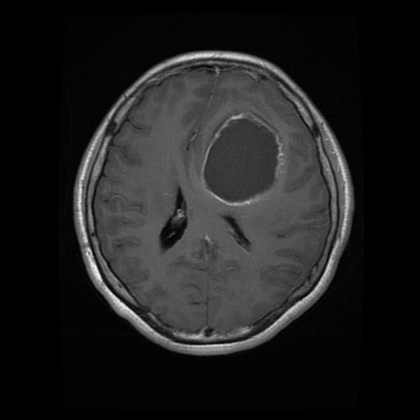
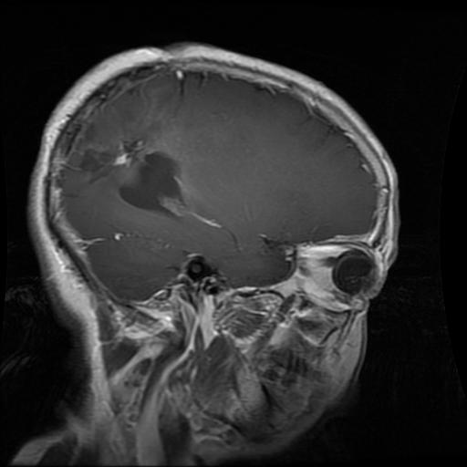
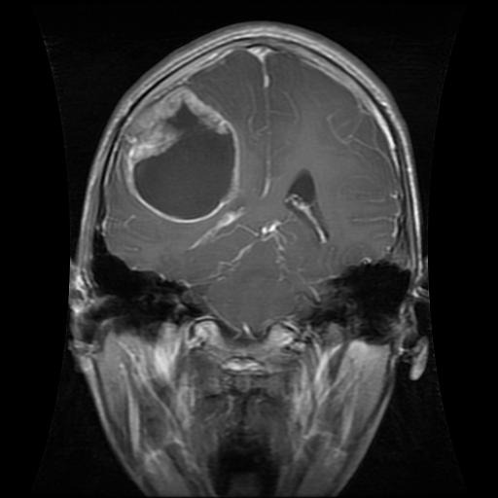
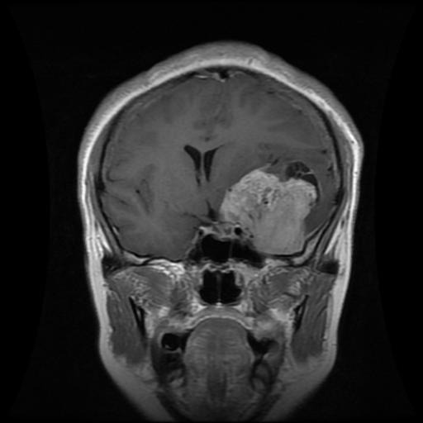
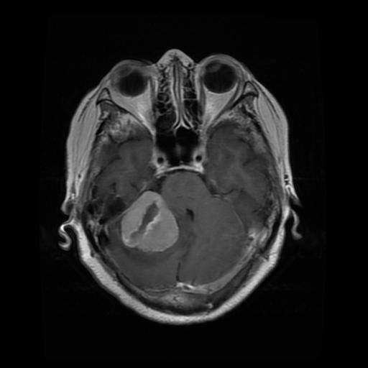
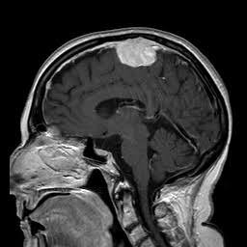
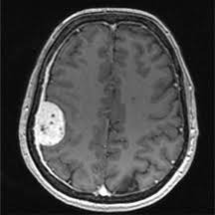
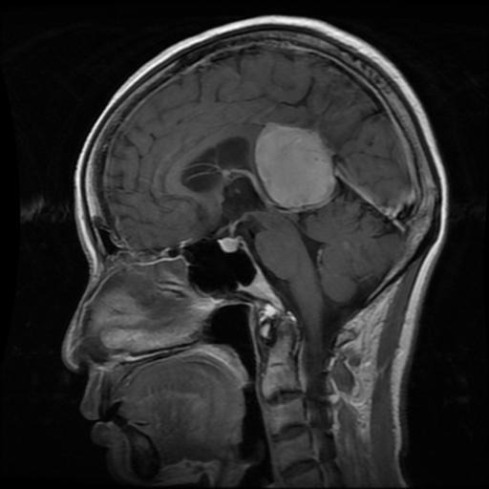
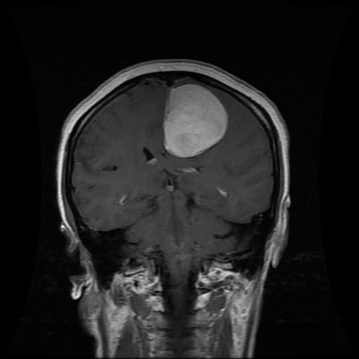
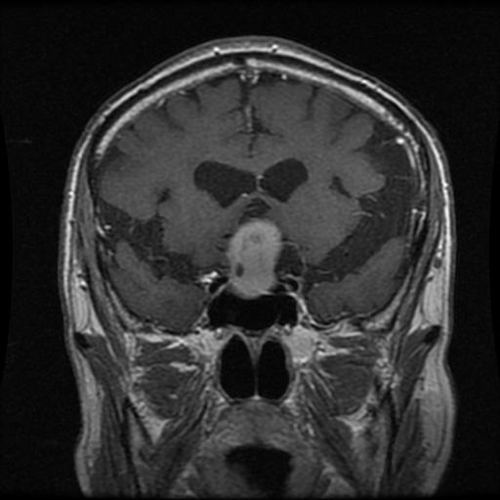
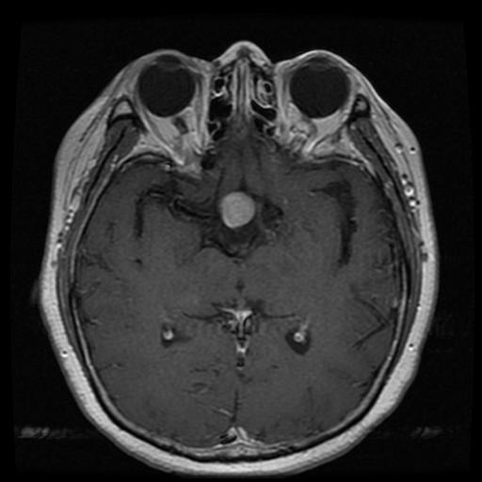
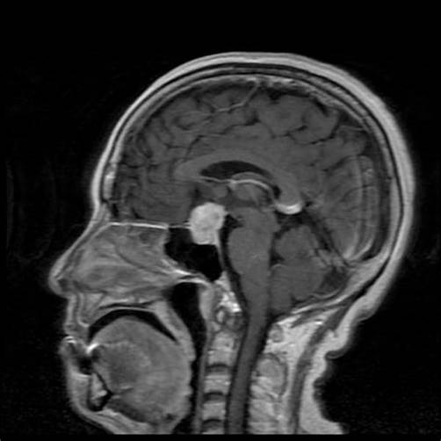
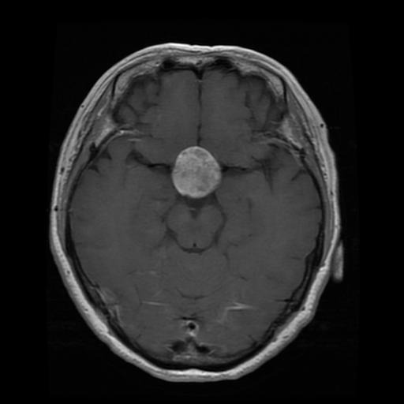
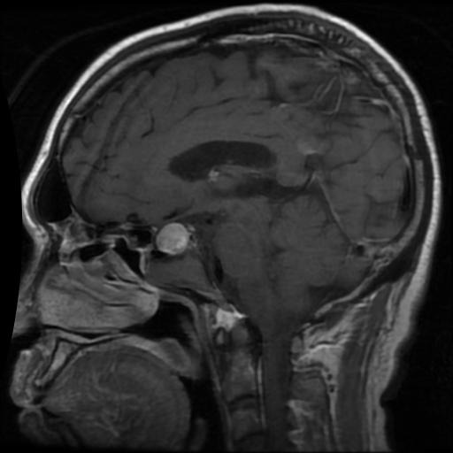

No tumor
Glioma
Meningioma
Pituitary

Slide 9
Working flow
Preprocessing
CNN
CNN
VGG16
XGBoost
EffectiveNetB3
stacking

Slide 10
Preprocessing
Original image (512, 512, 3)→dimensions reduction → (128, 128, 1)
Split to X & y → X.shape (5712, 128, 128, 1)
y_train = to_categorical(y, num_classes = 4)
Split to Train and validation
Train Validation Test
X.shape (4569, 128, 128, 1) (1143, 128, 128, 1) (1311, 128, 128, 1)
np.array(y).shape (4569, 4) (1143, 4) (1311, 4)

Slide 11

CNN_model
Fully connected
0.5
softmax

Slide 12

CNN architecture
0.5
4 x 4 x 256
1 x 1024
1 x 4096
1 x 4
128 x128 x1
32 x 32 x 128
8 x 8 x 128
128 x128 x 64
64 x 64 x64
64 x 64 x 128
16 x 16 x 128
8 x 8 x 256

Slide 13


Training

Slide 14


Validation

Slide 15
Stacking of CNN & XGBoost
4 x 4 x 256
1 x 1024
1 x 4096
1 x 4
128 x128 x1
32 x 32 x 128
8 x 8 x 128
128 x128 x 64
64 x 64 x64
64 x 64 x 128
16 x 16 x 128
8 x 8 x 256
Notes:
We took the output of this layer and used it as an input for the XGBoost.

Slide 16

XGBoost
X_train →(4569, 1024)
X_test → (1311, 1024)
xgb = XGBClassifier(objective='multiclass:softmax', learning_rate = 0.1, max_depth = 15, n_estimators = 500)
xgb.fit(X_train_features,np.argmax(y_train, axis=1))

Slide 17

CNN CNN+XGBoost
Accuracy : 0.90 Accuracy: 0.94

Slide 18

VGG16
base_model = VGG16(input_shape=(IMAGE_SIZE,IMAGE_SIZE,3),
include_top=False, weights='imagenet')
# Set all layers to non-trainable
for layer in base_model.layers:
layer.trainable = False
# Set the last vgg block to trainable
base_model.layers[-2].trainable = True
base_model.layers[-3].trainable = True
base_model.layers[-4].trainable = True
model = Sequential()
model.add(Input(shape=(IMAGE_SIZE,IMAGE_SIZE,3)))
model.add(base_model)
model.add(Flatten())
model.add(Dropout(0.3))
model.add(Dense(128, activation='relu'))
model.add(Dropout(0.2))
model.add(Dense(len(unique_labels), activation='softmax'))

Slide 19

VGG16

Slide 20


VGG16 training

Slide 21


VGG16 confusion matrix

Slide 22


EfficientNetB3
EfficientNet compound scaling method
involves scaling the network's depth, width, and resolution simultaneously.
This allows EfficientNet models to achieve state-of-the-art accuracy while using fewer resources compared to traditional approaches.

Slide 23


EfficientNetB3 training

Slide 24


EfficientNetB3 confusion matrix

Slide 25

VGG16
CNN
CNN + XGBoost
EfficientNetB3

Slide 26

Models comparison

Slide 27

Wrong classified
cases

Slide 28

The end.
Alin Finkelshtein and Felix Doctorman

